Slide 1
Real Estate Market In Korea
Executive Consultant, Yoon-Chul Choo

Slide 2
01. KOTRA & INVEST KOREA
Contents
02. Real Estate Market in Korea
03. Success Story
04. Development Project

Slide 3
KOTRA & INVEST KOREA
01

Slide 4
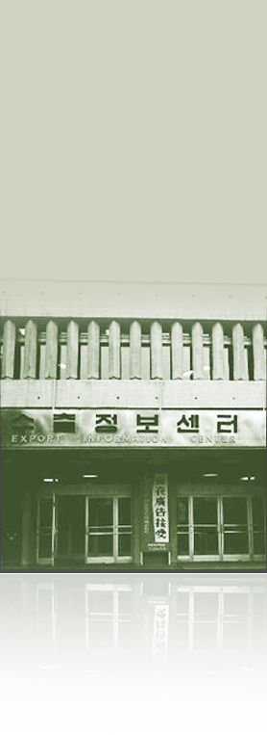
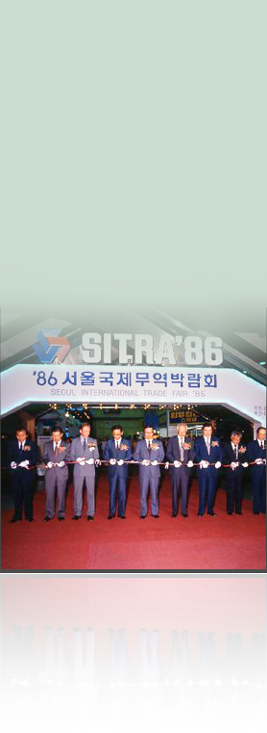
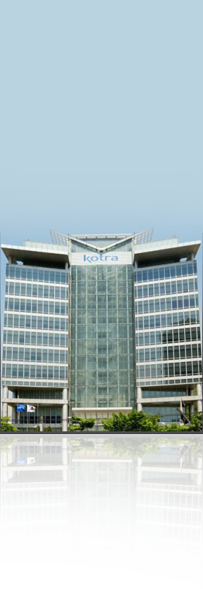
KOTRA, the Center of Economic Development in Korea!
Rewriting the history of the world economy
1960’s
1970’s
1980’s
1990’s
2000’s
Initiated export drive with the launch of KOTRA
The Export Information Center entered the global market
Laid the foundation to become a major exporter through KOTRA exhibitions
Overcame the IMF crisis as a national investment agency and led the nation as it became a trade giant
Joined the $1 trillion trade club through continued innovation in management
[$100 million in exports]
[$10 billion in exports]
[$50 billion in exports]
[$100 billion in exports]
[$500 billion in exports]

Slide 5
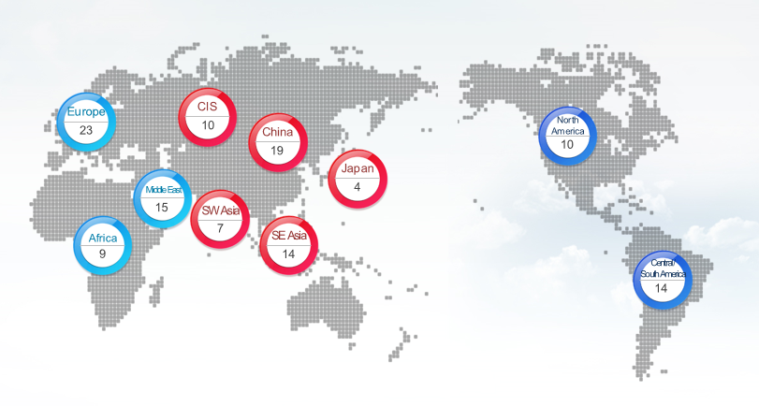
Located worldwide
10 local head offices, 126 Korea Business Centers (KBCs) in 86 countries
Notes:
Invest Korea is the national investment promotion organization of Korea.
We promote inbound foreign direct investment and we were started in 2003 as a part of the Korea Trade-Investment Promotion Agency, or KOTRA.
The FDI-inducing process begins with the central government, or the Ministry of Trade, Industry and Energy. The Korean government is committed to increasing FDI, and their efforts to provide foreign investors with better incentives and a better business environment are ongoing.
The Foreign Investment Committee you see below it is the highest decision-making body with regard to FDI in Korea
And finally, there’s KOTRA. Basically, what we do at Invest Korea is carry out the strategies and policies set by the Ministry of Trade, Industry & Energy, and we work to attract foreign direct investment.

Slide 6
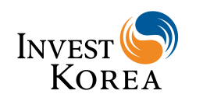
Introduction of Invest KOREA
History
2003
1999
1998
1998
1962
Invest KOREA is established
Office of the Foreign Investment Ombudsman opens
Korea Investment Service Center is established
Foreign Investment Promotion Act is enacted
KOTRA is established
- FDI Promotion Regime, Republic of Korea
Ministry of Trade, Industry & Energy
Foreign Investment Committee
KOTRA
Korea Trade-Investment Promotion Agency
Management
Support
SME
Support
Strategic Marketing
Business Information
Notes:
Invest Korea is the national investment promotion organization of Korea.
We promote inbound foreign direct investment and we were started in 2003 as a part of the Korea Trade-Investment Promotion Agency, or KOTRA.
The FDI-inducing process begins with the central government, or the Ministry of Trade, Industry and Energy. The Korean government is committed to increasing FDI, and their efforts to provide foreign investors with better incentives and a better business environment are ongoing.
The Foreign Investment Committee you see below it is the highest decision-making body with regard to FDI in Korea
And finally, there’s KOTRA. Basically, what we do at Invest Korea is carry out the strategies and policies set by the Ministry of Trade, Industry & Energy, and we work to attract foreign direct investment.

Slide 7
Real Estate Market in Korea
02

Slide 8
Trend of Real Estate Market in Korea
01
1997 ~ 1998
High Risk, High Profit (NPL, liquidity bond)
02
1999 ~ 2000
Profit Investment(Center of Seoul, Flowing) , Stable, Long-term Investment (Rent, Value Investing)
03
2000 ~2004,5
Development Project, Funds(Quota investment, Investment out of Seoul)
04
2010 ~ Now
Stable, long-term profit model

Slide 9
Main Issues in Real Estate Market
Because of global low interest-rate, it is easy to attract foreign investor.
Low Interest rate
Estimates steady profit making of the initial estate market due to diminishing supply of new office buildings
Has strength in service industry rather than manufacturing business because of long-term low growth.
Decrease of Supply
Low growth rate

Slide 10
Growth of Duty Free Shop
In July of 2016, size of Duty Free market became twice than 1 year before
2015.07
406.9 M dollars
2016.07
905.4 M dollars

Slide 11
Growth of Online Market
9 times
Unit: bil Won

Slide 12
About Logistics Market
Unit: billion
Unit: Trillion Won

Slide 13
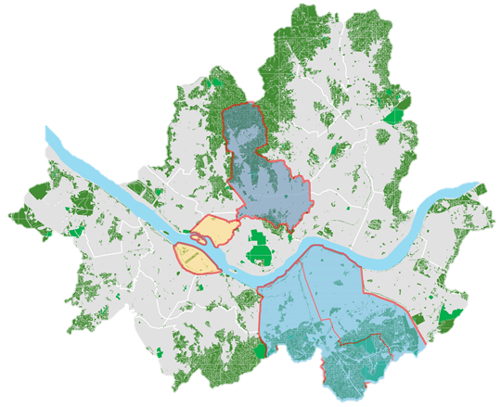
Office Market in Korea
CBD (Central Business District)
Average Building Age | 29 Years
Developed | Late 1960s
CBD is the oldest business district developed in the 1960’s, followed by YBD and GBD. The CBD is still the most prominent business district in Seoul with well established supporting facilities. Foreign banks, securities houses, embassies, and consulting companies dominate the CBD
Others
Others include office stocks in Seoul that do not belong to the three major business districts. The most prominent area it includes are Songpa, Jamsil, and Sangam (developed in 2011).
CBD
YBD
GBD (Gangnam Business District)
Average Building Age | 18 Years
Developed | Mid-Late 1980s
The Central Government designated GBD, formerly an agricultural area, as the second business district of Seoul. In the middle 1990’s, GBD was gaining popularity centering around Gangnam Rd and Teheran Rd. After IMF, GBD showed rapid rent hike. Now it’s home to Korea's conglomerate companies and the nation's largest center of global IT companies
GBD
YBD (Yeouido Business District)
Average Building Age | 25 Years
Developed | Early 1980s
In the late 1970’s through early 1980’s, YBD was developed as the ‘Manhattan of Seoul’ Local securities, media, and IT companies dominate the district due to its close proximity to Korea Stock Exchange and news broadcasting stations.

Slide 14
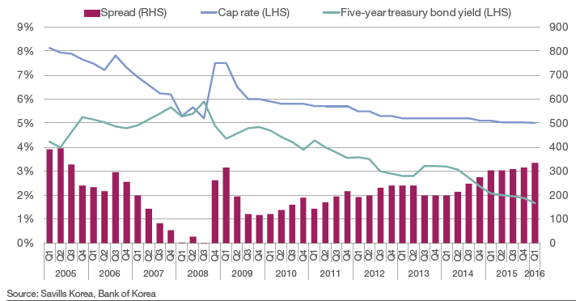
Cap rate index of Prime Office In Seoul 2005 ~ 2016
Stable Cap Rate

Slide 15
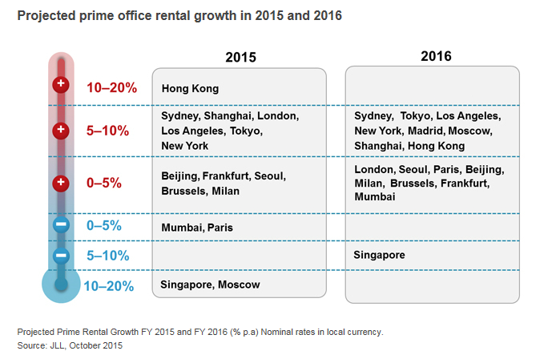
Prime Office Rental Growth Rate

Slide 16
REITS & FUND
The number of REITS 3.5 times,
Amount of Property 2.5times
Total amount of property(More than 18 trillion won)
Currently, 131 REITS Funds in Korea
REITS Fund
Average dividend rate 8.1%
Authorization of new REITS
41 REITS obtained authorization in 2015
Stable dividend rate
8.1% of dividend rate in average, and 9.5% in retail field, which is the highest dividend rate

Slide 17
REITS & FUND
Current state by type of property and profit rate
Office
Retail
Housing
Logistics
Hotel

Slide 18
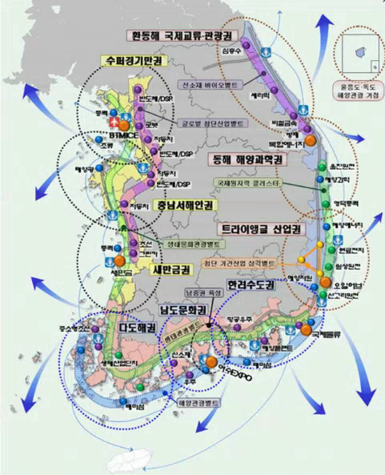
Major Development Plan of Korea

Slide 19
Success Story
03

Slide 20
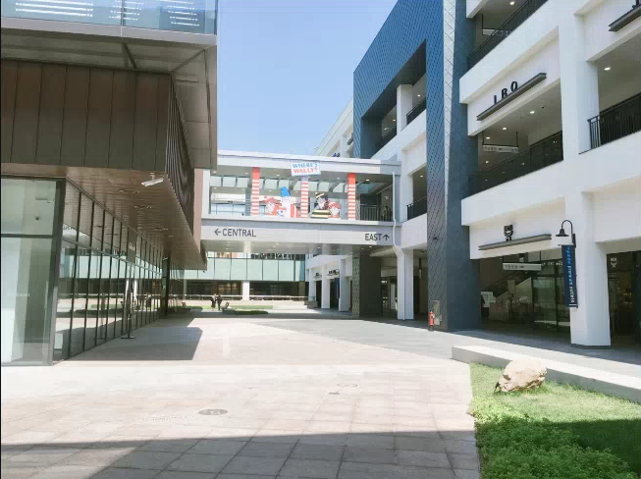
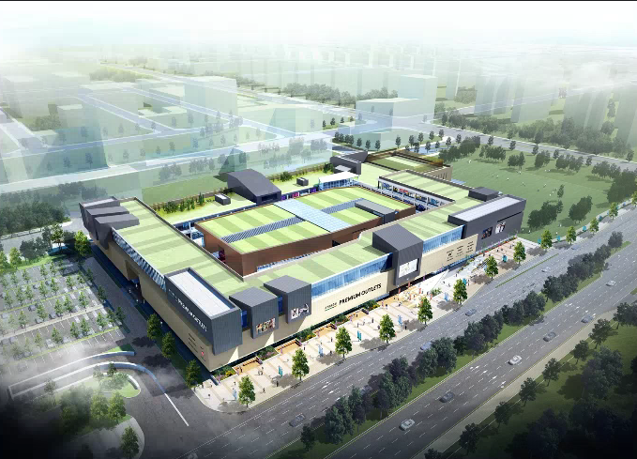
Premium Outlet
Name | Songdo Hyundai Premium Outlet
Location | Songdo3-dong, Yeonsu-gu, Incheon-si
Company | Hyundai Department Store
Open | Apr, 2016
Main Facilities | Grocery Store, Garden, Food Court
Area | 49,500m²
Features | New type of outside shopping mall, which was started in 2007 by Shinsegae
 | Songdo is rising region in Incheon and Lotte will also open multiplex in 2019.

Slide 21
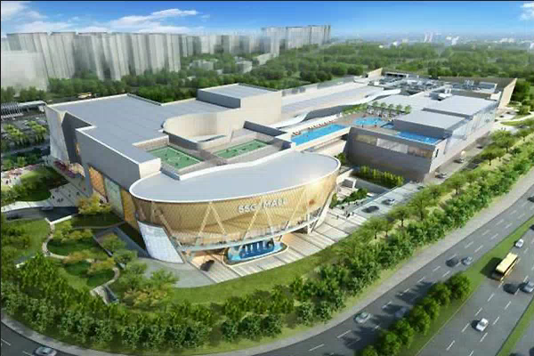
Multiplex
Name | Starfield First Hanam
Location | Shinjang-dong, Hanam-si, Gyeonggi-do
Company | Shinsegae Property(51%) Taubman Asia (49%)
Open | Sep, 2016
Main Facilities | Department Store, Aquarium, Theater, Food Court etc.
Area | 460,000m²
Features | It has big parking lot that can accommodate 5,600 cars.
 | First multiplex in Korea and Shinsegae will open ‘Goyang Starfield’ in Samsong-dong, Goyang-si.

Slide 22
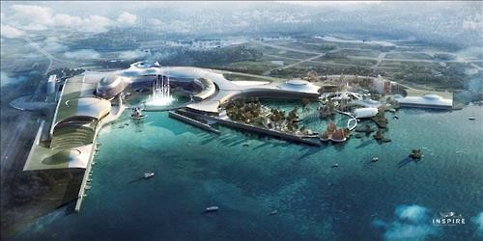
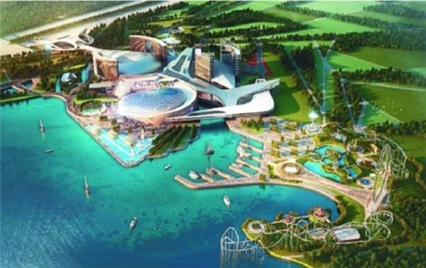
Mohegan Sun Inspire Complex Resort
Location | Yeongjong-do(Island), Incheon
Area | 3,274,000㎡
Project Costs | About 1.5 billion(stage 1), About 4.3 billion(Final)
Period | 2015 ~ 2020
Main Agent | Mohegan Sun
Main Facilities | - Casino Resort
 | - Arena(Concert hall and Stadium)
 | - Theme Park, Entertainment

Slide 23
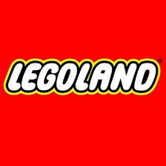
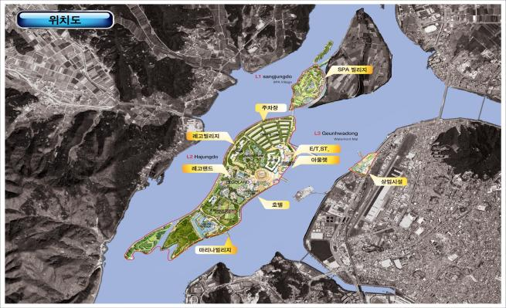
Lego Land
: The first LEGO Land in East Asia
Location | Within Chuncheon City , Gangwon-do
Area | 1,322,000㎡
Project Costs | USD 540 mill
Period | 2011~2018
Main Facilities | -LEGO Land Theme Park -Attractions -Hotels and Accommodations -Premium Outlet
Developer | Merlin Entertainments Group
Investors | SPC

Slide 24
Development Project
04

Slide 25
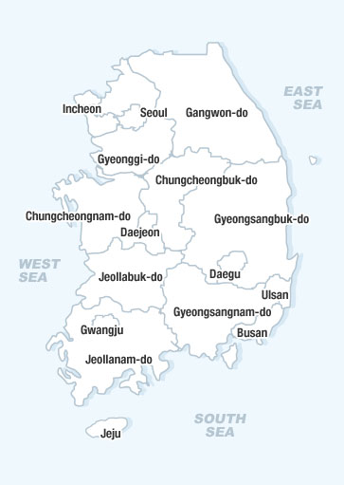
Regional Development Project
3 Projects
8 Projects
7 Projects
4 Projects
1 Project
1 Project
6 Projects
5 Projects
4 Projects
3 Projects
1 Project

Slide 26
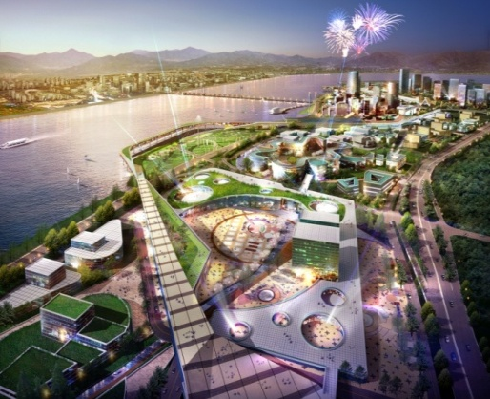
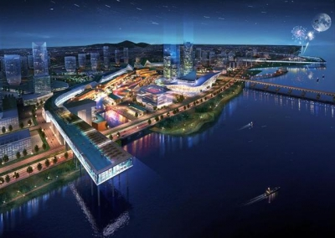
Regional Development Project
ZONE | Area(㎡)
Theme Park | 160,540
R&D | 51,610
Commercial Facilities | 111,850
Public | 400,140
■ Project Overview
-Project Title: Hangang Cine-Polis
-Location: Geolpo-Dong, Hyangsan-Lee, Gochon-eup
-Area(m²): 2,308,937
-Total Investment: $2 billion
-Development Duration: 2008-2016
-Target Investor: Land Developer
 | NPV(d/c rate:9%) | Project IRR
Business/Commercial Zone | $198 million | 36%
Leisure Complex Zone | $53 million | 15%

Slide 27
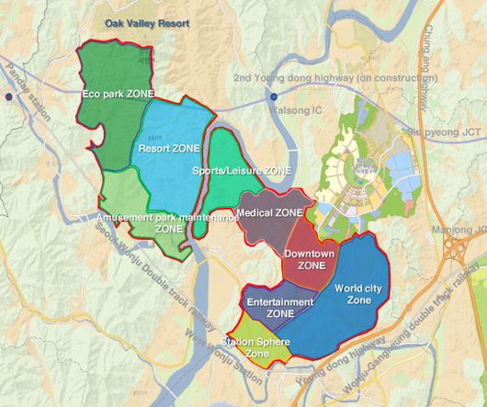
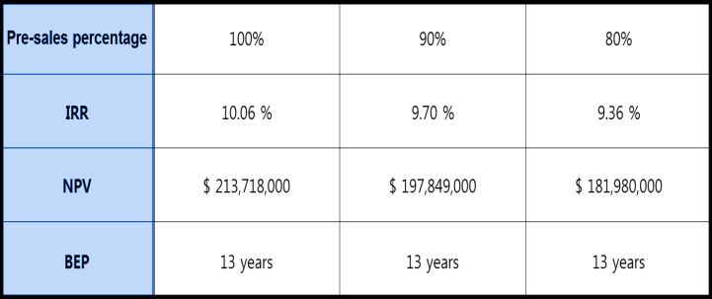
Regional Development Project
■ Project Overview
-Project Title: Wonju Tourism & Leisure City
-Location: Ji Jeong Myun, Gangwon Province
-Area(m²): 19,945,294
-Total Investment: $209 million
-Development Duration: 2015~2030
-Target Investor: Land Developer (Master
Developer)
ZONE | Area(㎡) | Introducing facilities
Resort ZONE | 3,386,816 | Hotels, golf courses, condominiums, ski resorts, casinos, water parks, commercial, cultural facilities, etc.
Sports/leisure ZONE | 1,756,743 | Sports Complex, MTB, off-road, kayaking, trekking, rock climbing, training, water sports facilities, etc.
Station Sphere ZONE | 934,145 | Shopping outlets, distribution complex, terminals, Station spheres Transit centers, shopping centers, tourist accommodation, etc.
World city-1 ZONE | 1,636,558 | Public housing, commercial facilities, business facilities, Green life facilities, schools, care facilities, migration facilities, etc. complex
Entertainments ZONE | 1,216,475 | Korean culture integrated complex, filming set, Studio, K-POP music concert hall, support facilities

Slide 28
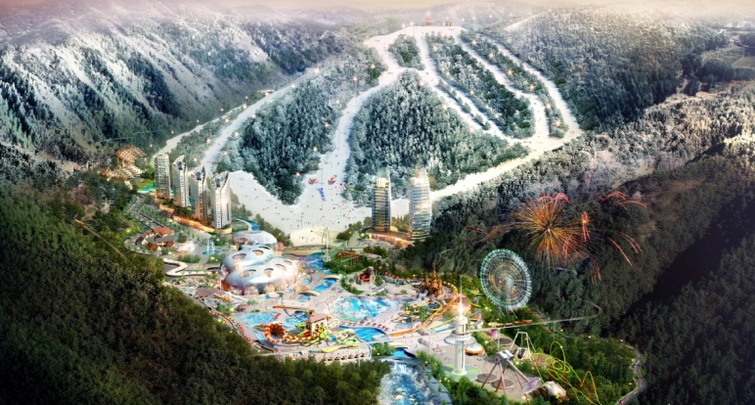
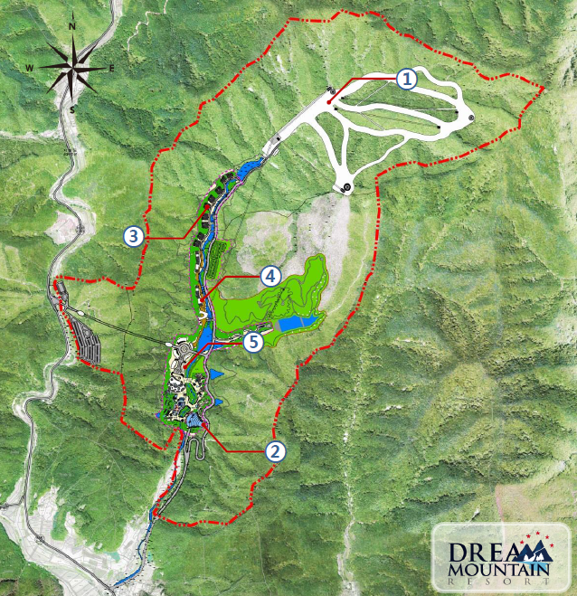
Regional Development Project
■ Project Overview
-Project Title: Dream Mountain Resort
-Location: 261-1 SukHwa-Ri, SeoWon-Myun, HoengSeong County, KangWon Province, Korea
-Area(m²): 3,580,397
-Total Investment: $ 530 million
-Development Duration: 2013– 2018
-Target Investor: FI
Zoning | Area (m²)
Ski | 289,448
Water Park | 75,384
Residence | 31,228
Residence Tower | 49,336
Shopping Outlet | 6,093

Slide 29
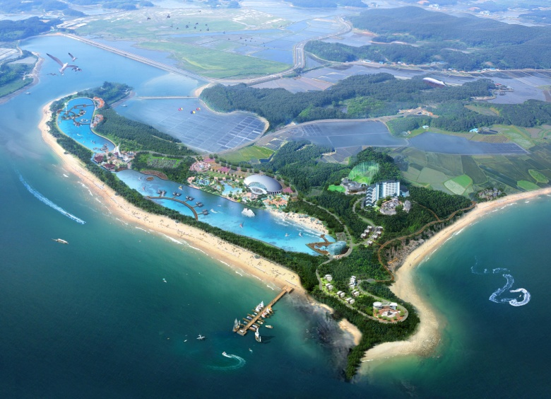
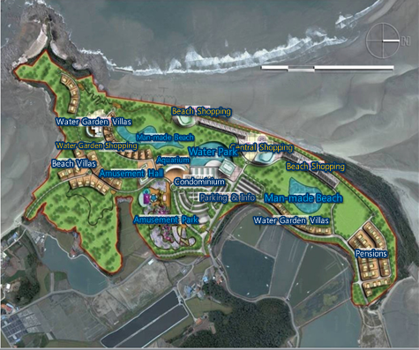
Regional Development Project
■ Project Overview
-Project Title: Anmyeondo Tourism Complex (UNYEO)
-Location: Anmyeon Island, Chungcheongnam-do
-Area(m²): 538,599 (UNYEO)
-Total Investment: $66.6 million (UNYEO)
-Development Duration: 2010~2020
-Target Investor: Land Developer (Master
Developer)
Category |  | Concept | Site Area(㎡) | GFA
Entertainment and Recreation | Amusement Hall | A thematic exhibition hall for children | 4,990㎡ | 4,491㎡
 | Amusement Park | Outdoor character theme park | 11,560㎡ | 1,734㎡
 | Water Park | 4-season water park for families | 12,705㎡ | 11,435㎡
 | Aquarium | West coast’s underwater world aquarium | 10,701㎡ | 9,631㎡
 | Man-made Beach | Purified seawater man-made beach | 18,356 ㎡ | -
Accommodations | Condominiums | Condos for group tours and families | 14,324㎡ | 12,892㎡
 | Water Garden Villas | High-end beach summer houses | 16,307㎡ | 14,676㎡
 | Beach Villas | 3-story terraced summer houses | 23,224㎡ | 20,901㎡
 | Pensions | Pensions for the mass market with diverse architecture | 21,089㎡ | 18,980㎡
Commercial | Central/Beach Shopping | Shopping, culture, and restaurants | 14,018㎡/10,212㎡ | 12,616㎡ / 9,191㎡
 | Water Garden Shopping | Convenience shopping | 5,960㎡ | 5,364㎡

Slide 30
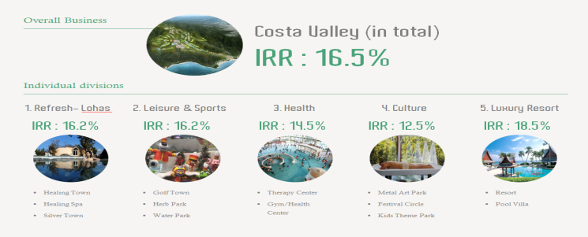
Regional Development Project
■ Project Overview
-Project Title: Pohang Costa Valley
-Location: Illwon, Gyewonri, Duwonri, Jangimyun, Namgu, Pohangsi, Gyeongsangbuk-do Province
-Area(m²): 2,814,585
-Total Investment: $590 million
-Development Duration: 2011-2020
-Target Investor: Land developer
Division |  | Recreational and cultural facilities | Recreational exercise | Accommodation | Commercial Facilities | Public Convenience Facilities | Green Area | Total
Primary Business | Area(㎡) | 252,946 | 946,135 | 222,837 | 22,002 | 133,736 | 675,744 | 2,253,400
 | Composition(%) | 11.2 | 42 | 9.9 | 1 | 5.9 | 30 | 100
Secondary Business | Area(㎡) | 161,823 | - | 57,584 | 9,720 | 11,184 | 326,214 | 556,804
 | Composition(%) | 27.3 | 0 | 10.3 | 1.7 | 2 | 58.6 | 100
Business (in total) | Area(㎡) | 405,049 | 946,135 | 280,421 | 31,722 | 144,920 | 1,001,958 | 2,810,204
 | Composition(%) | 14.8 | 33.7 | 10 | 1.1 | 5.2 | 35.7 | 100

Slide 31
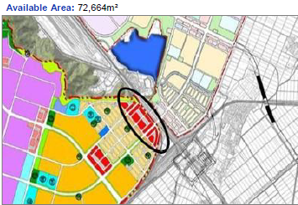
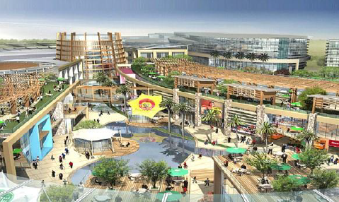
Regional Development Project
Location | Osong-eup, Heungdeok-gu, Cheongju-si, Chungcheongbuk-do
Total Area | 72,664m²
Area of Commercial Zone | Outlet: 53,981m²
Main Facilities | Premium Outlet, Hotel, R&D Center, Theme Park, Healthcare Service Center etc.

Slide 32
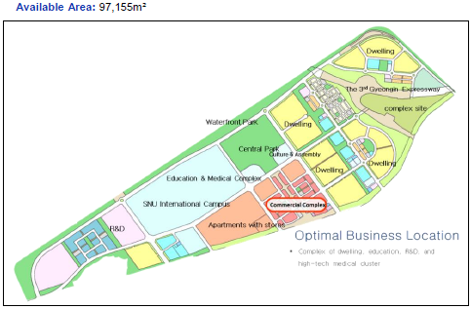
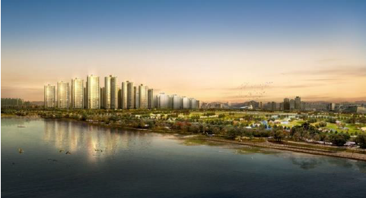
Regional Development Project
Location | Jeongwang-dong, Siheung-si, Gyeonggi-do
Total Area | 351,869m²
Development Possible Area | 97,155m²
Main Facilities | - Business Hotel - Strip Mall - Department Store - Premium Outlet

Slide 33
Thank you
Yoon-Chul, Choo
Real Estate Executive Consultant
Investment Promotion Administration Team
T +82(0)2-3460-7884
F +82(0)2-3460-7943
M +82(0)10-8761-5197
E c8543033@kotra.or.kr

